Slide 1
AIChE National Meeting technical program - Analysis
By Nitin Agarwal

Slide 2
Agenda
Overview
Analysis Results
Approach
Tools & Techniques
Future Work

Slide 3
Overview
Mine the data in the AIChE National Meeting technical program to answer the following questions:
Treat the talks in the Food, Pharmaceutical and Bioengineering Division
How many talks are from industry versus academia?
What are some of the key themes/concepts that are being discussed within the reference corpus?
Treat the rest of the data in the AIChE Technical program as a design corpus
What are some of the themes being discussed in the design corpus? (achieved by mining the talk title, session title and abstract if available)
How are they different or similar to the topics discussed in the reference corpus?

Slide 4
Analysis
Food, Pharmaceutical and Bioengineering Division

Slide 5
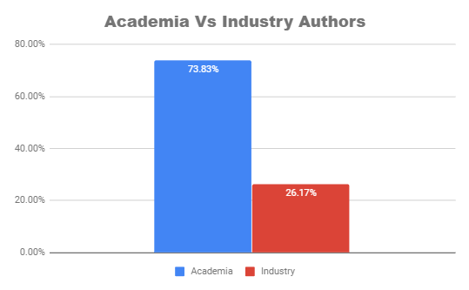
Author Affiliation
Under the talk “Food, Pharmaceutical and Bioengineering Division”, 73% of the topics have been presented by Academic authors.

Slide 6
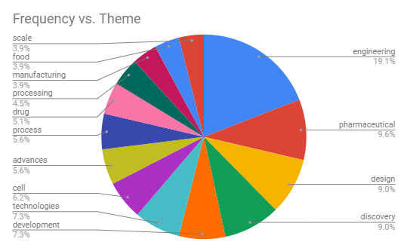
Key terms discussed

Slide 7
Analysis
Other Talks in AIChE National Meeting technical program

Slide 8
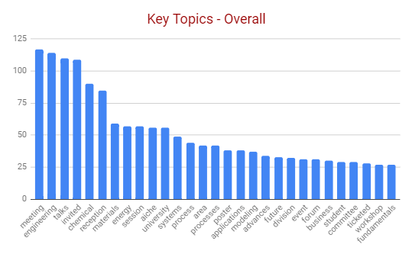
Key terms discussed by authors

Slide 9
Topics Similarity
Based on Jacarrd similarity score of .17, We can infer that the major topics discussed in the talk “Food, Pharmaceutical and Bioengineering Division” has slight similarity with the topics discussed in the other talks.

Slide 10
Approach

Slide 11
Workflow
Data Collection
Data Processing
Analysis
Develop automated web scraping framework in R to communicate with AIChE website using PhantomJS utility.
Export HTML files to a particular location.
Extract data from HTML files using Rvest package in R.
Remove unwanted characters, punctuations, stop words etc.
Based on the Title text, extracted the terms and calculated the frequency to understand their importance.
Used Jaccard Index to understand the similarity between two key terms sets.

Slide 12
Tool and Techniques
R, R studio
Google Chrome plugin Gadget Selector
PhantomJS

Slide 13
Future Work
Better web scraping solution.
Improved text comparison.
Analyse Author attributes
Analyse Talk’s schedule and geographic details

Slide 14
Thank you.

